Slide 1
Employee Management System Project Presentation By Jobayer mahamud

Slide 2
ABSTRACT
Employee Management System is a distributed application, developed to maintain the details of employees working in any organization. It maintains the information about the personal details of their employees, The application is actually a suite of applications developed using Java.
It is simple to understand and can be used by anyone who is not even familiar with simple employees system. It is user friendly and just asks the user to follow step by step operations by giving him few options. It is fast and can perform many operations of a company.

Slide 3
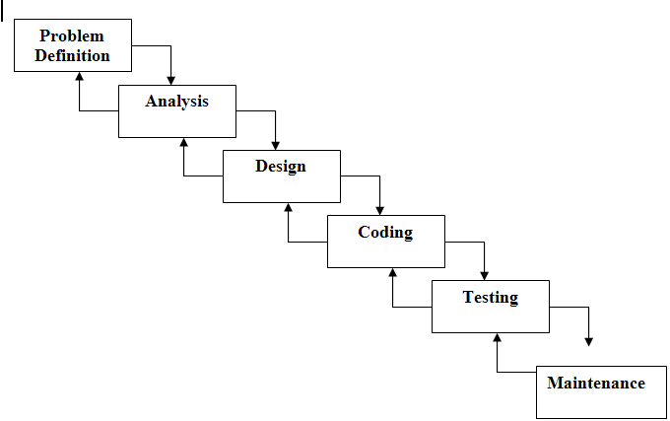
Software Life Cycle Model

Slide 4
Hardware Requirements
Memory Space:
Minimum - 32 MB
Recommended - - 64 MB
HDD - To install the software at least 2 GB and the data storage is depending upon the organizational setup.
PROCESSOR - Intel Pentium IV, 1GHZ or above
ram - 256MB or above
VIDEO - 1024x768, 24-bit colors
KEYBOARD - Standard 104 Keys(QWERTY)

Slide 5
Software Requirements
Operating SysteM -Windows or Linux
Developing LanguagE- JAVA(jdk-7)
DATABASE – MySql
SERVER-Apche
TOOLS-Netbeans,xampp

Slide 6
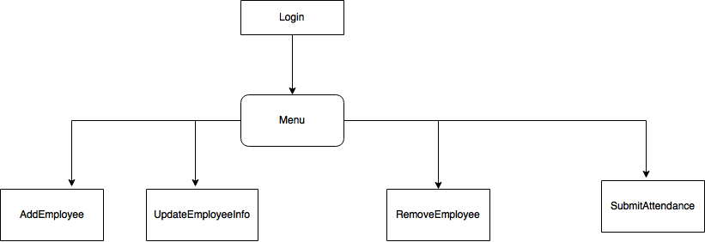
System Design

Slide 7
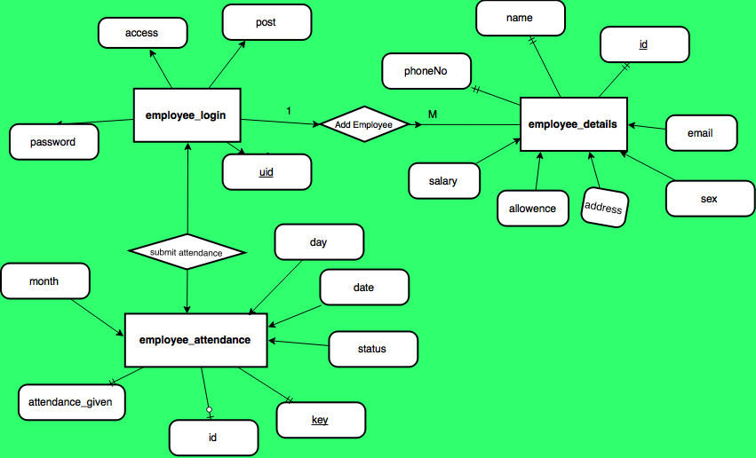
E-R Diagram

Slide 8
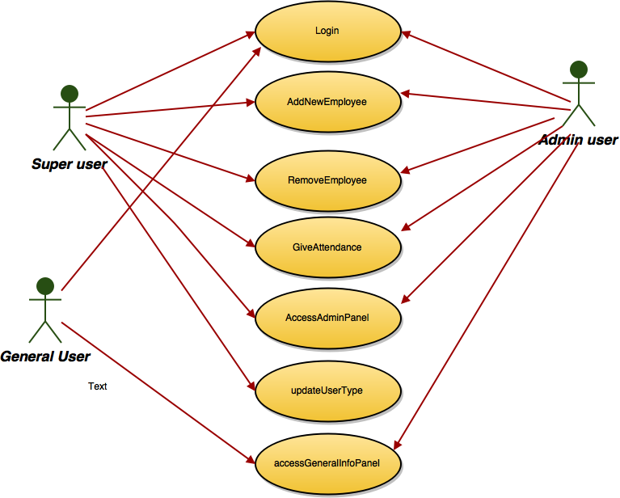
Use case Diagram

Slide 9
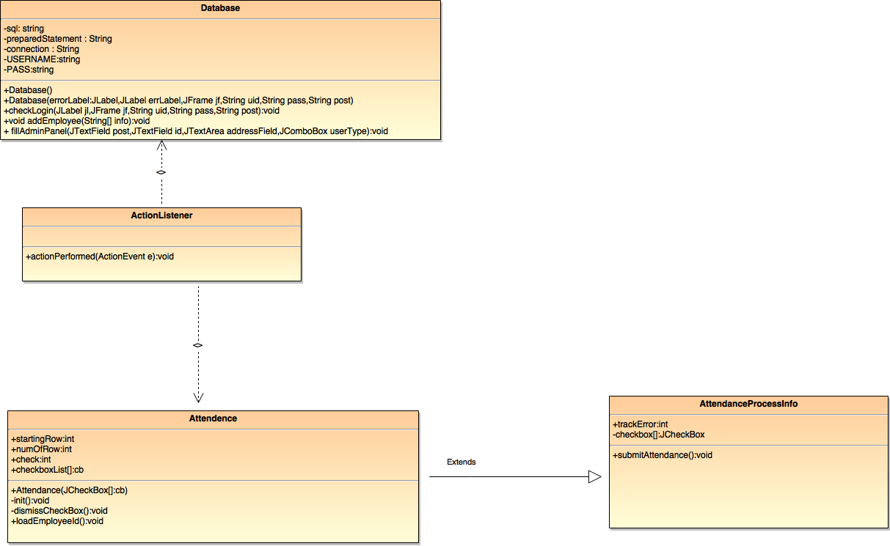
Class Diagram

Slide 10
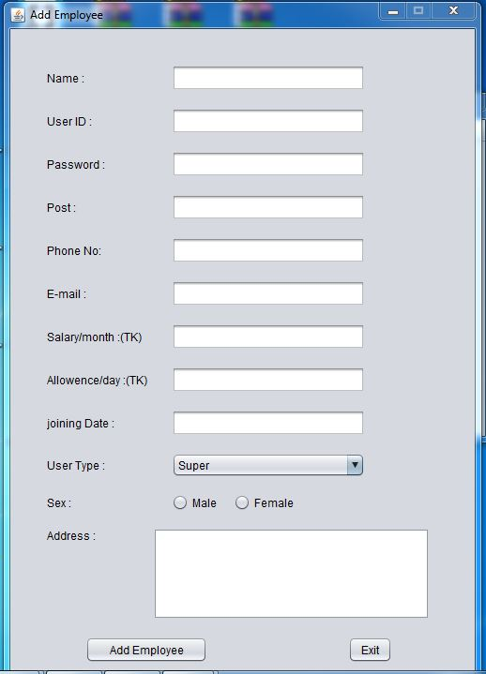
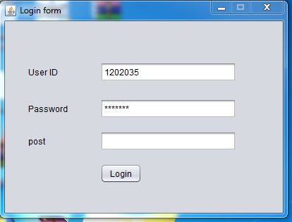
Screen shots

Slide 11
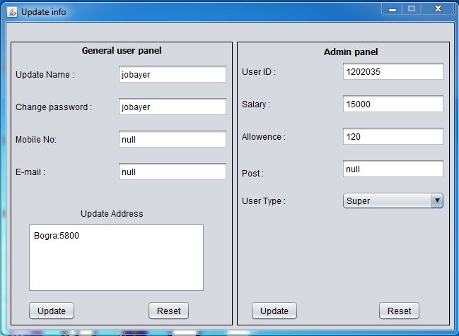
Screen shots

Slide 12
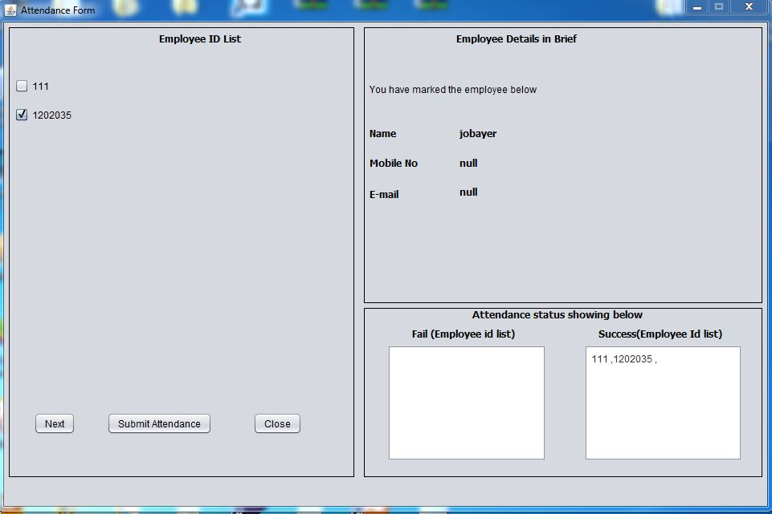
Screen shots

Slide 13
Future plan
1.Send notification to employee via E-mail.
2.improve UI design
3.integrate payment gateway

